Slide 1

Introduction to Robotics
2016 Fall

Slide 2
Review
Class | Date | Project | Finished?
1 | 9/06/16 | Introduction of Robot and Robotics, mBot Assembly | yes
2 | 9/13/16 | Introduction of mBlock | yes
3 | 9/20/16 | Play an Octave | yes
4 | 9/27/16 | Push a Button | yes
5 | 10/04/16 | Light Sensor, UltraSonic Sensor | yes
6 | 10/11/16 | Drive with Remote, Line Following | yes
7 | 10/18/16 | Robot Movement 1 | yes
8 | 10/25/16 | Robot Movement 2, Trace a Shape | yes
9 | 11/01/16 | Obstacle Avoidance | yes
10 | 11/08/16 | Sumo Wrestling 1
11 | 11/15/16 | Sumo Wrestling 1
12 | 11/22/16 | Maze
13 | 11/29/16 | Servo and Autonomous Car
14 | 12/06/16 | Term Challenge
15 | 12/13/16 | Robotics in the future

Slide 3
Term Challenges
1. Remove the default program from the robot
2. Choose Challenge A or B
A. Mount the LED block, Joystick block, and Potentiometer block. Write a program to use the joystick to control which LED is lit up; use Potentiometer to control the brightness of the LED.
B. Implement a temperature sensory system: a) 7-segment to display the temperature in Celsius; b) LED to code the temperature, 20 degree in Blue, 30 degree in Red, 25 Green, and gradual change from 20 → 25 → 30. Below 20, White; Above 30, Purple.

Slide 4
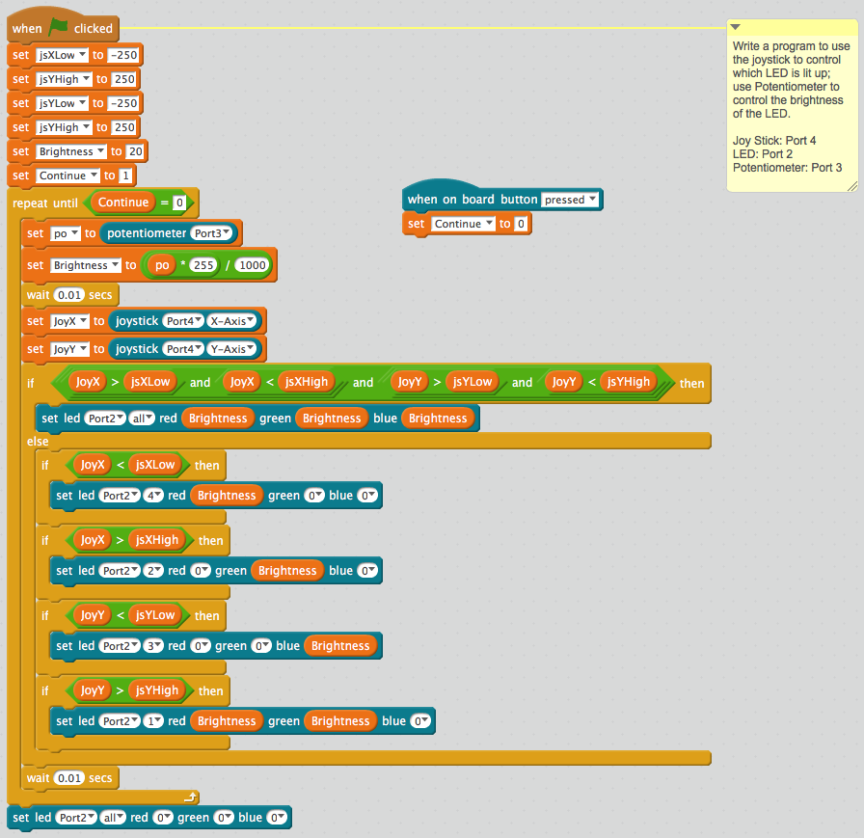
Joystick
and LEDs

Slide 5
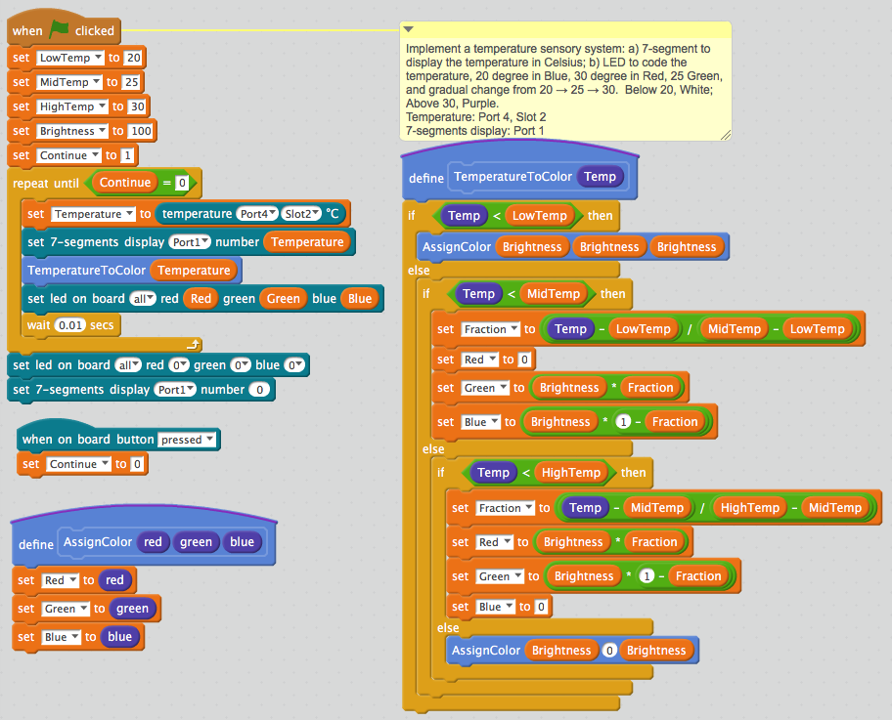
Temperature Sensory System

